Slide 1
Lab diagnosis
Specimen : pus ,wound swab ,urine ,sputum ,blood ,CSF
Culture:
Nutrient agar :bluishgreen pigment diffused in medium
Mc Conkeys agar :pale colonies
Peptone water :surface pellicle &green pigment
Selective medium like cetrimide agar useful to inoculate p.aeruginosa from faeces

Slide 2
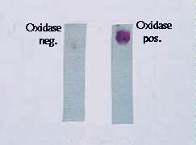
MICROSCOPY – Gram negative & motile
BIOCHEMICAL REACTIONS
OXIDASE – POSITIVE
Non fermenters
Breaks down Glucose with acid production
TYPING METHOD
Pyocin typing is most commonly used

Slide 3
TREATMENT
Ciprofloxacin Piperacilin
Ticarcillin Azlocilin
Cefotaxime Ceftazidine
Gentamycin

Slide 4
CONTROL
Constant vigilance & strict attention to asepsis.
Polyvalent vaccine has to be recommended.

Slide 5
Stenotrophomonas maltophila
Saprophyte &opportunistic pathogen
It causes:
Wound infection
UTI
Septicemia
BIOCHEMICAL REACTIONS
Oxidase negative
Acidifies maltose in addition to glucose, lactose ,sucrose
Treatment
Cotrimoxazole & chloramphenicol

Slide 6
Burkholderia mallei
Isolated by Loeffler & Shutz from horse dung of glandlers
MORPHOLOGY
Small 2.5µm × 1.5µm,non-motile , gram –ve bacilli
beaded appearance
CULTURE
Aerobe & facultative anaerobe.
On ordinary culture media, colonies are small & translucent initially
become yellowish & opaque on ageing.

Slide 7
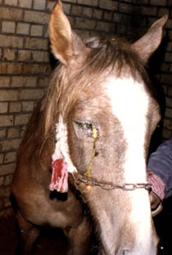
Animal pathogenicity:
Suscpetible animals are horses , mules & asses
2 types of lesions
GLANDERS:
Respiratory system is affected
Nodule formation & profuse discharge in
nasal septum & later turns to ulcer.
FARCY:
It is infection through skin with involvement
of superficial lymph nodes & lymph vessels.
Lymph vessels convert into farcy pipes.

Slide 8
STRAUS REACTION:
Intraperitonial inoculation of bacilli in male guinea pig
causes testicular swelling in 2-3 days due to
inflammation of tunica vaginalis
It is not a diagnostic of glanders because similar reaction is observed with Brucella sps, Priesz nocard bacillus, Actinobacillus & B.pseudomallei.
HUMAN PATOGENICITY:
Infected via skin abrasions or wounds with infected animal.
Disease may present as acute fulminant febrile illness or
a chronic indolent infection producing abscesses in
respiratory tract or skin.
In acute glanders there is fever,nasal discharge,prostation. Fatality rate is high.

Slide 9
LAB DIAGNOSIS:
SPECIMEN – Purulent discharge
DIRECT MICROSCOPY- -Gram-ve beaded bacilli on gram staining
CULTURE—Done on Blood agar
ANIMAL INOCULATION--Done on guinea pig for Straus reaction
ALLERGY TEST
Mallein test –Delayed hypersenstivity reaction

Slide 10
Burkholderia pseudomallei
It is formerly called as Whitmore’s bacillus
Actinobacillus whitmori
Malleomyces pseudomallei
Loeffflerella pseudomallei
It was first described by Whitmore & Krishnaswami.
It is the causative agent of meliodosis(melis:disease of asses,eidos:resemblance)
MORPHOLOGY:
Resembles B.mallei but motile in nature.
CULTURE:
Resembles B.mallei

Slide 11
Pathogenesis:
Saprophyte of soil & water
Infection is by
Inhalation
Through skin abarasion
Arthropod vector
it may be an Acute septicaemia
Sub acute typhoid like disease
Pneumonia &
Hemoptysis resembling Tuberculosis
Acute diseases have high fatality rate

Slide 12
LAB DIAGNOSIS:
SPECIMEN –Purulent exudates , Urine , Blood , Sputum
MICROSCOPY--Small , typical , bipolar safety pin appearance on Methyl blue stain
SEROLOGY-Antibody to B.pseudomallei detected in patient serum by ELISA , IHA.

Slide 13
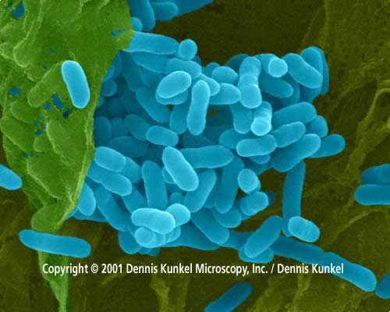
Melioidosis:safety pin appearance

Slide 14
Burkholderia cepacia
MORPHOLOGY :
Slender, gram negative , motile due to multitrichous flagella
Bacillus accumulates poly β hydroxy butyrate as granules
hence stain irregularly
CULTURE :
Aerobic , grows at optimum temp. 25 – 35
Grows well on ordinary nutrient agar
On prolonged incubation colonies become redddish purple
due to formation of a non diffusable phenazine
pigment

Slide 15
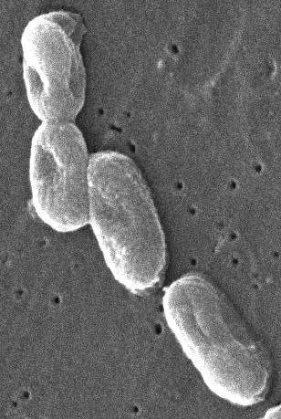

Slide 16
pathogenicity
Important cause of nosocomial infection
It is an opportunist environmental pathogen,particularly in those with cystic fibrosis it cause fatal necrotising pneumonia
Resistant to large number of antibiotics
Contaminate antiseptic solutions like chlorhexidine&cetrimide

Slide 17
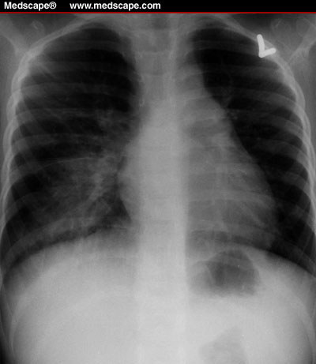

Slide 18
Non fermentors other than psedomonas & burkholderia
Acinetobacter :saprophyte of soil causing pneumonia & respiratory tract infections
Alcaligenes :present in faeces causing UTI & wound infection
Achromobacter :causes :post operative meningitis
Flavobacterium :saprophyte of soil causing nosocomial infections in infants
Eikinella :commensal of mucosal surface causes endocarditis,meningitis & pneumonia

Slide 19
THANK YOU
.

