Slide 1
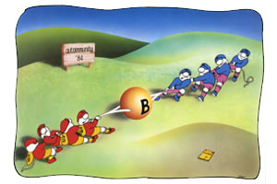
AUTOIMMUNITY

Slide 2
DEFINITION:
Any structural or functional damage produced by the action of immunologically competent cells or antibodies against the normal cells is known as autoimmunity

Slide 3
CONTRADICTION IN TERMINOLOGY
Autoimmunity literally means ‘protection against self’ but it actually means ‘injury to self’
The term ‘autoallergy’ has been suggested but the term autoimmunity has wide usage.

Slide 4
HISTORY
Metalnikoff(1900) observed sperm immobilising antibodies against the sperms of their own in guinea pig. This was the earlist example of autoimmunity.
Donath and landsteiner(1904) identified circulating autoantibodies in paroxysmal cold hemoglobinuria. This was the first description of autoimmune disease in human beings

Slide 5
Even though autoantibodies are harmful to body, some autoantibodies like anti-idiotypic antibody are essential for normal functioning of immune system.

Slide 6
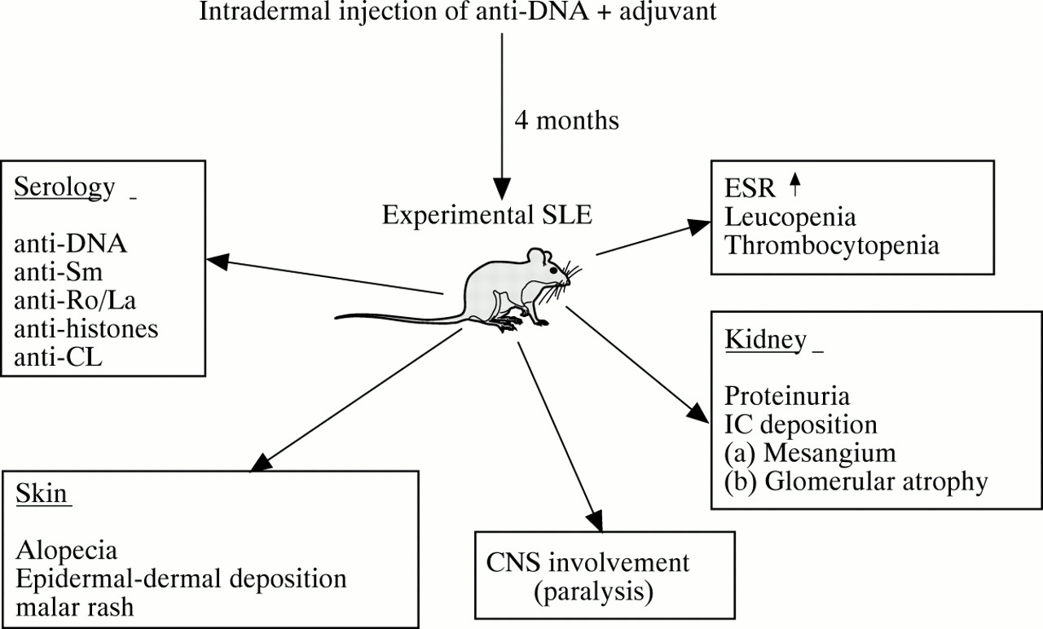
Autoimmunity can be explained in experimental animals by injection of self antigens along with complete Freund’s adjuvant.

Slide 7
Diseases of autoimmune origin exhibit following features:
An elevated level of immunoglobulins
Demonstrable autoantibodies
Deposition of immunoglobulins or their derivatives at sites of election such as renal glomeruli
Accumulation of lymphocytes and plasma cells at sites of lesion
Benefit from corticosteroid or immuno suppresive therapy.

Slide 8
Occurrence of more than one type of autoimmune lesion in an individual
A genetic predisposition towards autoimmunity
Higher incidence among females
Chronicity, usually non reversible

Slide 9
However, mere presence of autoantibodies during course of disease does not prove their causative role.
Autoantibody formation may be result of tissue injury and the antibody may help in promoting immune elimination of damaged cells or tissue elements.
A typical example is lepromatous leprosy.

Slide 10
The relative importance of humoral and cellular immunity in autoimmune disease is not known.

Slide 11
MECHANISMS
OF
AUTOIMMUNITY

Slide 12
NEOANTIGENS
PHYSICAL : irradiation, photosensitivity, cold allergy
CHEMICAL : drugs, chemicals, metals etc.
BIOLOGICAL : microorganisms - viruses, bacteria
MUTATIONS

Slide 13
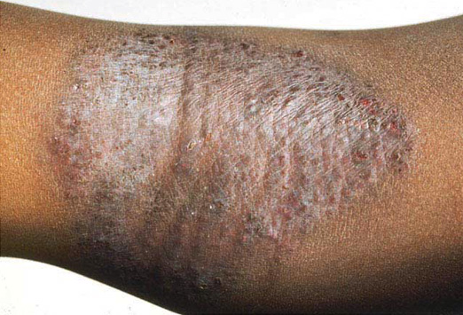
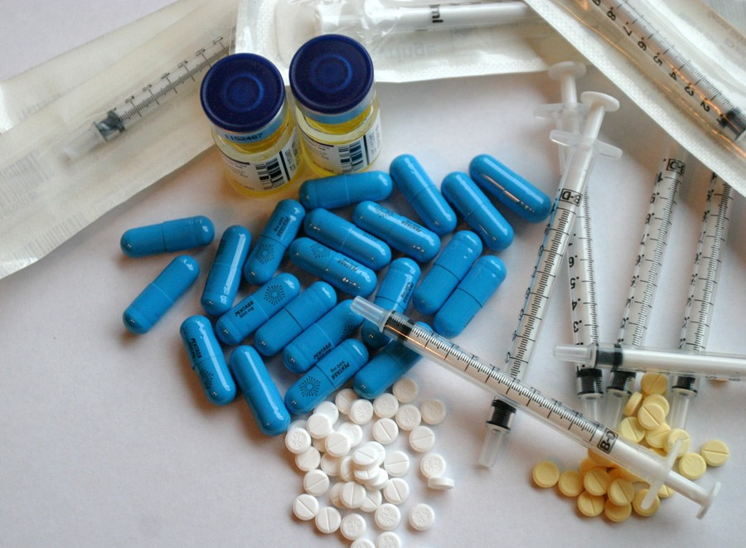

Slide 14
CROSS - REACTING ANTIGEN THEORY

Slide 15
MOLECULAR MIMICRY THEORY
EX: Arithritogenic shigella flexneri – HLA-B27
Mycobacterium tuberculosis - joint memb
coxsackie B - Myocardium

Slide 16
POLYCLONAL B CELL ACTIVATION

Slide 17
BRAEKDOWN OF IMMUNOLOGICAL HOMEOSTASIS

Slide 18
ENHANCED HELPER T CELLS AND DECREASED SUPPRESSOR T CELL FUNCTIONS

Slide 19
SEQUESTRATED ANTIGENS

Slide 20
DEFECTS IN IDIOTYPE - ANTI-IDIOTYPE NETWORK

