Slide 1
FILTRATION

Slide 2
A FILTER is a membrane or other porous substance for separation of impurities or particulate matter from liquid or gas

Slide 3
Filtration is a method of sterilizing liquids and gases
It is used to remove bacteria from heat-labile liquids

Slide 4
Heat-labile liquids include SERA SOLUTIONS OF SUGARS ANTIBIOTICS

Slide 5
It is used to prepare bacteria-free filtrates of clinical samples for virus isolation.

Slide 6
Filter discs help to concentrate bacteria from liquids
Ex: testing water samples for vibrio,salmonella,etc

Slide 7
Bacterial toxins can be obtained by passing cultures through filters

Slide 8
The following types of filters are commonly used:
Candle filters
Asbestos filters
Sintered glass filters
Membrane filters

Slide 9
CANDLE FILTERS
They are of 2 types
a. Unglazed ceramic filters
Ex:Chamberland and Doulton
b. Diatomaceous earth filters
Ex:Berkefeld and Mandlers

Slide 10
These are widely used for purification of water for industrial and drinking purposes
Porosity 0.65 to 15µm

Slide 11
Disadvantages:
They are fragile
They easily crack
Some cracks remain undetected
Turbid water may plug them during cleaning

Slide 12
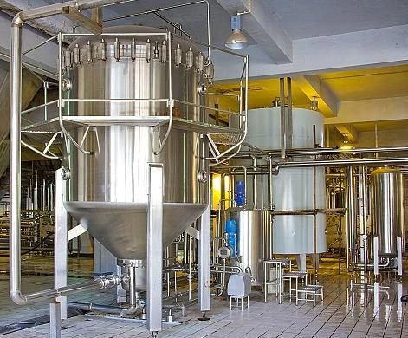
Industrial candle filter

Slide 13
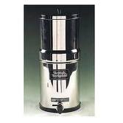
Common candle filter

Slide 14
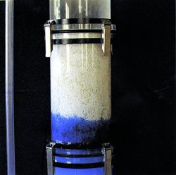
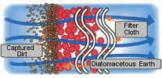
Diatomaceous earth filters

Slide 15
ASBESTOS FILTERS
They are single-use discs
They have high absorbing capacity and alkalinise filtered liquids

Slide 16
Disadvantages:
Asbestos is a potent carcinogen
Hence the use of these is discouraged

Slide 17
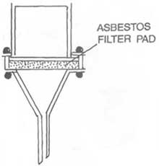
Ex: seitz filter
sterimats filter

Slide 18
SINTERED GLASS
FILTERS
Finely powdered glass particles of graded sizes are heat fused
They have low absorbing capacity and hence can be cleaned easily

Slide 19
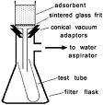
Disadvantages:
They are brittle and expensive

Slide 20
MEMBRANE GLASS FILTER
They are made of cellulose esters or other polymers
They are used in:
water purification and analysis
sterilisation and sterility testing
preparing solutions for
parenteral use

Slide 21
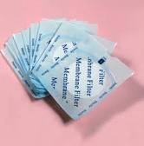
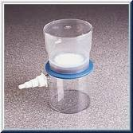
The pore diameters range from 0.015 to 12 µm
0.22µm is most commonly used

Slide 22
AIR FILTERS
Deliver clean bacteria free air to cubicle or room
HIGH EFFICACY PARTICLE ARRESTERS – used in laminar system in labs

Slide 23
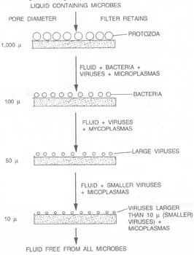

Slide 24
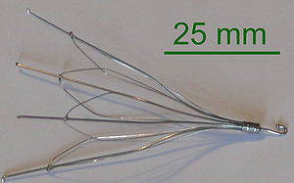
Venacaval Filter

Slide 25
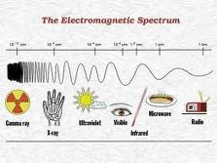
RADIATION
Is energy emitted from atomic activities & dispensed at high velocities through matter or space

Slide 26
Two types of radiation are used for sterilisation
1) ionising radiation
2) Non-ionising radiation

Slide 27
Non-ionising radiation
These are comparitively low energy type radiations
They are absorbed to a large extent as heat
Ex:UV rays
IR rays

Slide 28
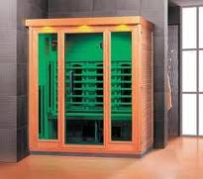

Slide 29
Hence it is considered a form of hot air sterilisation
Infra red rays are used for rapid mass sterilisation of prepacked items like syringes
Ultra violet rays – for sterilising internal surfaces of safety cabinets, OTs

Slide 30
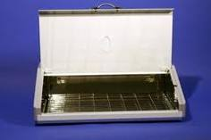
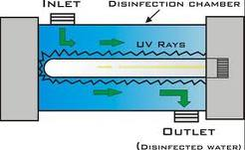
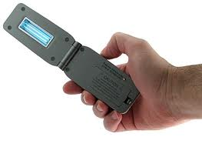
1
2
3

Slide 31
Ionising radiation
They are high energy type of radiation
They act by destroying DNA and other vital constituents
Ex: X-rays
Gamma rays
Cosmic rays

Slide 32
They have high penetrative power
Bacillus pumilis is the control
COLD STERILISATION- there is no rise of temperature
Hence they are used to sterilize heat sensitive objects like syringes, catheters, oils etc

Slide 33
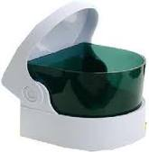
ULTRASONIC AND SONIC VIBRATIONS
Sound vibrations at high frequency in upper audible and ultrasonic range are used.

Slide 34
SoSONIC WAVES

Slide 35
Mechanism:
passage of sound through a liquid produces alternating pressure changes, which if the sound intensity is great causes cavities to form in the liquid
These cavities grow till they collapse violently cause cytoplasmic damage to the organism

Slide 36
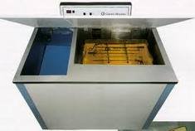

Slide 37
It is of no practical value
It is used to treat sewage water & in research laboratories

Slide 38
CHEMICAL AGENTS
Chemical agents are widely used as antiseptics and disinfectants

Slide 39
Properties of an ideal antiseptic or disinfectant:
A wide spectrum of activity
Activity in presence of organic matter
Activity in at all pH
Speedy action
High penetrating power
Stability i.e. no reactivity
contd…

Slide 40
Compatibility with other antiseptics and disinfectants
Non corrosive to metals
No local reaction or sensitisation
No interference with healing
Non toxic if absorbed
Inexpensive – Available – Safe & easy to use

Slide 41
But such an ideal chemical is yet to be found

Slide 42
Various modes of action of chemical agents are
PROTIEN COAGULATION
DISRUPTION OF CELL MEMBRANE
DISRUPT ENZYME FUNCTION
SUBSTRATE COMPETITION

Slide 43
Potency of disinfectants is determined by:
Concentration of the substance
Time of action
pH of the medium
Temperature
Nature of the organisms
Presence of extraneous material

Slide 44
Disinfection is of three levels
HIGH LEVEL- Ex gluteraldehyde
hydrogen peroxide
peracetic acid
chlorine compounds
INTERMEDIATE- Ex alcohols
iodophores
phenols
LOW LEVEL-

Slide 45
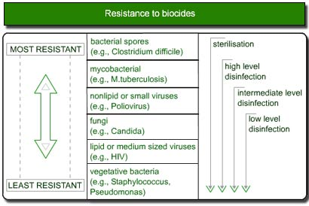

Slide 46
The chemical agents commonly used are:
ALCOHOLS
ALDEHYDES
DYES
HALOGENS
PHENOLS
GASES
SURFACE ACTIVE AGENTS
METALLIC SALTS

Slide 47
ALCOHOLS
they are hydrocarbons with hydroxyl group
They are stable in reaction
They are active as a 60-90% solution.
Mechanism of action- denaturation of proteins

Slide 48
Ethyl alcohol
Isopropyl alcohol
these are the commonly used disinfective alcohols

Slide 49
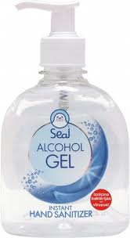
Ethanol is used as
a disinfectant
Solvent
Preservative
Rubifacient
Astringent
As haemostatic, etc,.

Slide 50
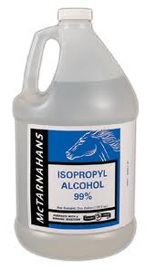
Isopropyle alcohol is preferred as it is a better
fat solvent
Less volatile
More bactericidal

Slide 51
METHYL ALCOHOL is effective against fungal spores.
Hence it is used to treat cabinets and incubators.
Disadvantages:
The vapour is toxic and flammable.

Slide 52
ALDEHYDES
Chemically they are hydrocarbons with a -CHO group.
They act by denaturation of protiens
by acting against the amino group.

Slide 53
Two extensively used aldehydes are
1) FORMALDEHYDE
2) GLUTERALDHYDE

Slide 54
Formaldehyde
It is markedly bactericidal and sporicidal
It has lethal effects on viruses.
It is used to preserve anatomical specimens
To cleanse hair and wool
To sterilise metal instruments-
10% formalin + 0.5% sodium tetraborate

Slide 55
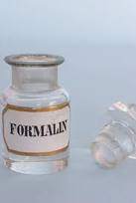
It is used for sterilising instruments & heat sensitive catheters
For fumigating wards sick rooms and laboratories
Disadvantages:
irritant and toxic when
inhaled
Surfaces after disinfection give
off irritant vapour

Slide 56
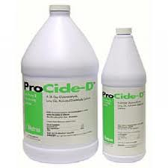
GLUTERALDEHYDE
It is also called gluteral
It is effective against gram positive and negetive bacteria, acid fast bacilli, spores, fungi & viruses.

Slide 57
Advantages over formaldehyde
It is less toxic and irritant to eyes and skin
No deleterious effect on lenses or cement of instruments
It can be safely used on corrugated rubber tubes, face masks etc,.

Slide 58
It is used for tissue fixation as it preserves fine detailed structure of cell by localisation of enzyme activity.

Slide 59
DYES
-are any of the various coloured substances thatcontain auxochromes and thus are capable of colouring substances to which they are exposed
They are used extensively as skin and wound antiseptics

Slide 60
Two groups of extensively used dyes are
1. aniline dyes
2. acridine dyes

Slide 61
ANILINE DYES are more active against gram positive organisms
They act by reacting with acidic groups in the bacterial cell
They are inhibited by organic matter

Slide 62
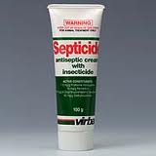
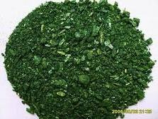
They are used as selective agents in culture media
Ex: BRILLIANT GREEN
MALACHITE GREEN
CRYSTAL VIOLET

Slide 63
ACRIDINE DYES are not as selective as aniline dyes
They are more effective against gram positive bacteria
They act by impairing DNA complexes of the organisms

Slide 64
They are very little affected by organic matter.
If impregnated on gauze they are slowly released in moist environment
Ex: PROFLAVINE
ACRIFLAVINE
EUFLAINE
AMINACRINE

Slide 65
OXIDISING AGENTS
These agents act by the release of free radicles which bring about oxidation
Ex: HYDROGEN PEREOXIDE
PERACETIC ACID
PLASMA STERILISATION

Slide 66
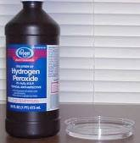
HYDROGEN PEROXIDE
It acts by releasing free hydroxyl group
Most organisms are susceptible at a conc of 3 – 6%
Spores at 10 – 25%
Used to treat contact
lenses

Slide 67
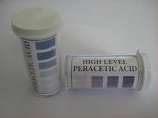
PERACETIC ACID
It is a high level disinfectant
It releases ACETIC ACID & OXYGEN

Slide 68
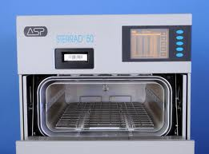
PLASMA STERILISATION
Plasma refers to any gas which consists of electrons ions or neutral particles
The resulting uv radiation causes destruction of organisms including spores

Slide 69
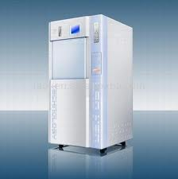
GAS PLASMA STERILISER

Slide 70
HALOGENS (HALO-SALT; GEN-FORMING)
These include chlorine
iodine which are widely used disinfectants
they are used in solid liquid and gaseous form

Slide 71
IODINE
It is used in aqueous & alcoholic solutions
It is actively bactericidal
It is active against tubercle bacilli and viruses
It has moderate action on spores
Iodophores are compounds of iodine with nonionic wetting agents are more active.

Slide 72
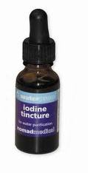
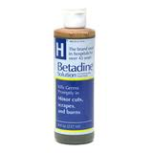

Slide 73
CHLORINE
It is markedly bactericidal
Has wide spectrum of action against viruses
It is available as hypochlorites
Organic chloramines are used as antiseptics for dressing wounds
Disinfection of water supplies, swimming pools, etc, is done

Slide 74
