Slide 1
HYPERSENSITIVITY
TYPE II AND TYPE III REACTIONS

Slide 2
TYPE II – CYTOLYTIC AND CYTOTOXIC
Involve a combination of IgG or rarely IgM
Cytotoxic or Cytolytic effects
Antigenic determinants on the surface of the cell leads to those effects.
Examples: Autoimmune hemolytic anemia Hemolytic disease of the newborn

Slide 3
CONTD..
Alternatively a free antigen or a hapten may be absorbed on cell surfaces
They combine with corresponding antibodies leading to cell damage
Example: Hemolytic anemia Thrombocytopenic purpura Agranulocytosis

Slide 4
This cell lysis occurs in the presence of Compliment or Mononuclear cells
Type II reactions are intermediate between Hypersensitivity and autoimmune reactions.
Rarely it may cause stimulation instead of destruction Eg: LATS – Long Acting Thyroid Stimulator
Hyper thyroidism

Slide 5
Antigen on cell
Specific antibody
Cytotoxic attack by Killer cells
Antigen antibody complex
Opsonic adherence to phagocytes
C1423
LYSIS
Immune adherence to phagocytes
Ag+Ab+C1423
C56789
Mechanism

Slide 6
CONTD..
Rarely, Abs combine with cell surface receptors and disrupts normal functions
Disruption
Agonist (uncontrolled) Eg: Graves disease
Antagonist (Blocking) Eg: Myasthenia gravis

Slide 7
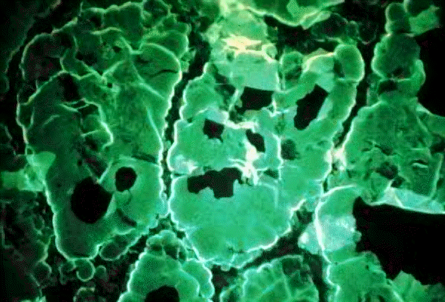
This image was made by the use of a goat antisera, tagged with fluorescein, made against human IgG to detect human autoantibodies bound to the thyroid tissue. In this case, anti-thyroglobulin antibody is detected. The thyroid follicle colloid is stained positively.

Slide 8
TYPE III - IMMUNE COMPLEX DISEASES
Type III hypersensitivity occurs when antigens and antibodies (IgG or IgM) are present in roughly equal amounts, causing extensive cross-linking.
It is characterized by soluble antigens that are not bound to cell surfaces (which is the case in type II hypersensitivity).

Slide 9
CONTD..
When these antigens bind antibodies, immune complexes of different sizes form
Large complexes can be cleared by macrophages but they have difficulty binding to small immune complexes for clearance.
These immune complexes insert themselves into tissues and induce an inflammatory response, and can cause damage wherever they precipitate.

Slide 10
ARTHUS REACTION
Repeated injections of horse serum to rabbits Initial injections Later injections
No local effect Edema
Induration
Hemorrhagic necrosis

Slide 11
MECHANISM
Ag-Ab precipitation
Compliment activation
Release of inflammatory molecules
Increased vascular permiability
Infilration with neutrophils

Slide 12
CONTD..
Leucocyte Platelets Thrombi
Decreased blood supply
Tissue necrosis

Slide 13
CONTD..
Examples for ARTHUS REACTION Intrapulmonary Arthus like reaction to inhaled antigens such as Thermophilic actinomycetes from mouldy hay or grain FARMER’S LUNG

Slide 14
SERUM SICKNESS
Systemic form
Described by Pirquet and Schick
Injection of high conc of foreign serum (Diphtheria toxin) 7-12 days
Fever, Lymphadenopathy, splenomegaly, arthritis, GN, Endocarditis, Vasculitis, Urticarial
rashes, abd pain, nausea, vomiting

Slide 15
CONTD..
Self limiting
Continuous rise in AB production
Larger Immune complexes
More phagocytosis
Immune elimination

Slide 16
Single injection serves as both sensitizing dose and shocking dose – different from other Hypersensitivity reactions

Slide 17
Immune complexes occur in Many diseases (Bacterial, Viral, parasitic) Disseminated malignancies Autoimmune diseases Deposition of IC Nephritis , Arthritis

