Slide 1
DISINFECTANTS

Slide 2
Phenols :
Distillation of coal tar (170-270 ºc).
‘LISTER’ first introduced them in surgery
MOA: Phenols disrupt cell membrane& precipitate proteins
PHENOL(Carbolic Acid):
-powerful microbicidal substance
-derived from coal tar
-widely used disinfectant in hospitals

Slide 3
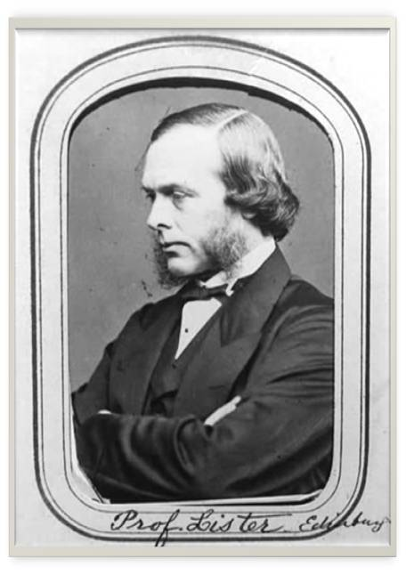

Slide 4
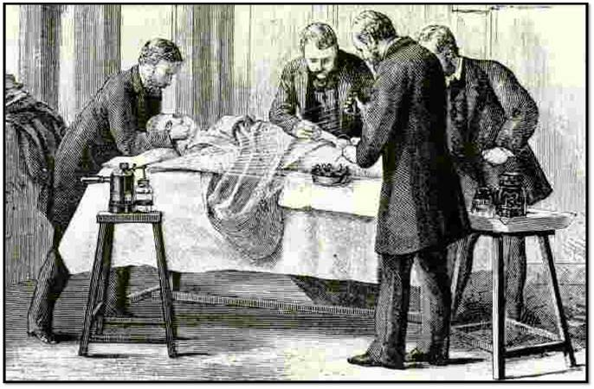

Slide 6
LYSOL & CRESOL: -active against wide range of organisms. -not readily inactivated by organic matter, hence GOOD general Disinfectants. - toxic to humans. CHLOROPHENOLS & CHLOROXYPHENOLS: -less toxic & less irritant. -less active& readily inactivated by organic matter -both are relatively inactive against pseudomonas -various combinations of these are used in the control of pyogenic cocci in surgical & neonatal units in hospitals .

Slide 8
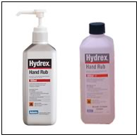
HEXACHLOROPHENE: -potentially toxic& should be used with care CHLORHEXIDINE(Hibitane): -relatively non-toxic - SKIN ANTISEPTIC -most active against Gm+ve & fairly effective against Gm-ve organisms -aqueous solutions are used in the treatment of wounds

Slide 9
GASES :
ETHYLENE OXIDE:
-colorless liquid , boiling point 10.7 ºc
-highly penetrating gas with ethereal smell
-highly inflammable & highly explosive and thus limits its use in fumigation
How its explosive tendency is eliminated?
-mix it with inert gases like Co2 or N2 to a
concentration of 10%

Slide 10
MOA: alkylation of amino, carboxyl, hydroxyl, sulphydryl groups in protein molecules -In addition , it also reacts with DNA&RNA USES: -effective against all types of microbes including viruses & spores -used for sterilizing heart-lung machines, respirators, dental equipment , books & clothing -successfully used to sterilize a wide range of materials like glass, metal & paper surfaces, soil, clothing, tobacco etc.,

Slide 11
DISADVANTAGES: -potentially toxic to human beings -highly MUTAGENIC&CARCINOGENIC -acts as an IRRITANT FORMALDEHYDE GAS: -widely employed for fumigation of operation theatres and rooms . - usage as : 150g KMno4 + 280 ml formalin for every 1000 cu.ft. -the reaction produces considerable heat, so heat resistant vessels should be used

Slide 12
-when formaldehyde vapour is generated, the doors should be sealed& left unopened for 48 hours BETA PROPIOLACTONE: -condensation product of ketane & formaldehyde with b.p. 163 ºc USES: -capable of killing all micro organisms -very active against Viruses -0.2%BPL used for sterilization of biological products ADVANTAGES: more efficient for fumigating purposes than formaldehyde DISADVANTAGES: it has carcinogenic activity

Slide 13
SURFACE-ACTIVE AGENTS:
DEFINITION: substances that alter the energy relationship at interfaces, producing a reduction of surface or interfacial tension.
CLASSIFICATION:
-cationic
-anionic
-nonionic
-amphoteric

Slide 14
CATIONIC SAA: -act on phosphate groups of cell membrane and also enter the cell -membrane loses its semi permeability & cell proteins are denatured -cationic compounds in the form of quaternary ammonium compounds are markedly bactericidal, being active against Gm+ve organisms -they have no action on spores, tubercle bacilli & viruses Eg: acetyl trimethyl ammonium bromide, benzalkonium chloride

Slide 15
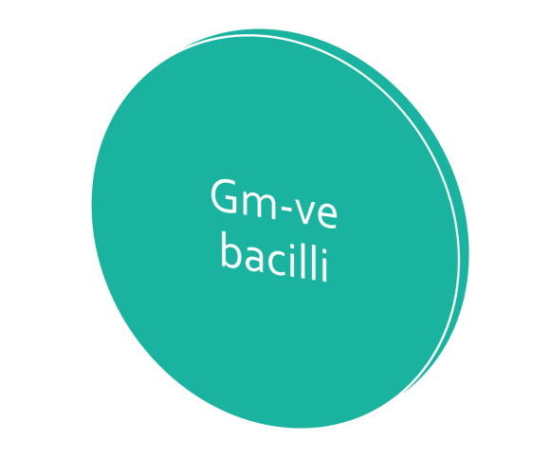
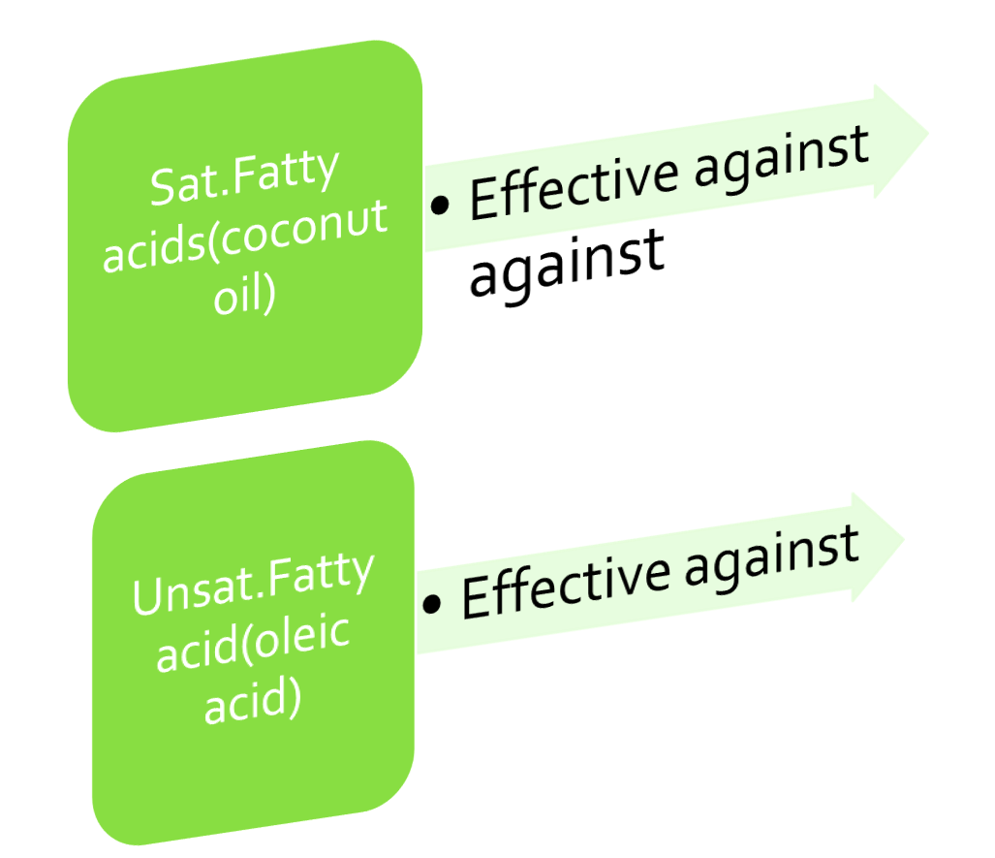
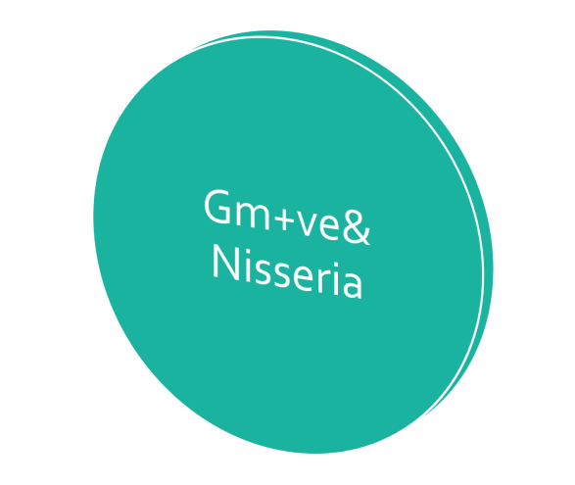
ANIONIC SAA:(Eg: soaps) -moderate action SOAPS prepared from

Slide 16
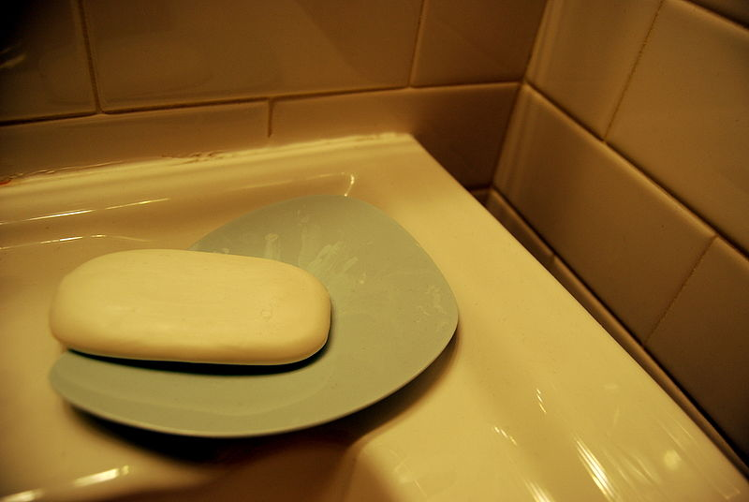

Slide 17
AMPHOTERIC or AMPHOLYTIC COMPOUNDS: -also known as ‘TEGO’ compounds -active against wide range of Gm+ve & Gm-ve and some viruses -not in general use now

Slide 18
METALLIC SALTS :
-These are protein coagulants and have
capacity to combine with free sulphydryl
groups of cell enzymes when used in appropriate conditions
-Hgcl2: highly toxic, once used as disinfectant
-Cu salts: used as fungicides
-Thiomersal, phenyl mercury nitrate and
mercurochrome are less toxic& used as mild
antiseptics
-They have marked bacterioSTATIC but weak bactericidal& fungicidal action

Slide 19
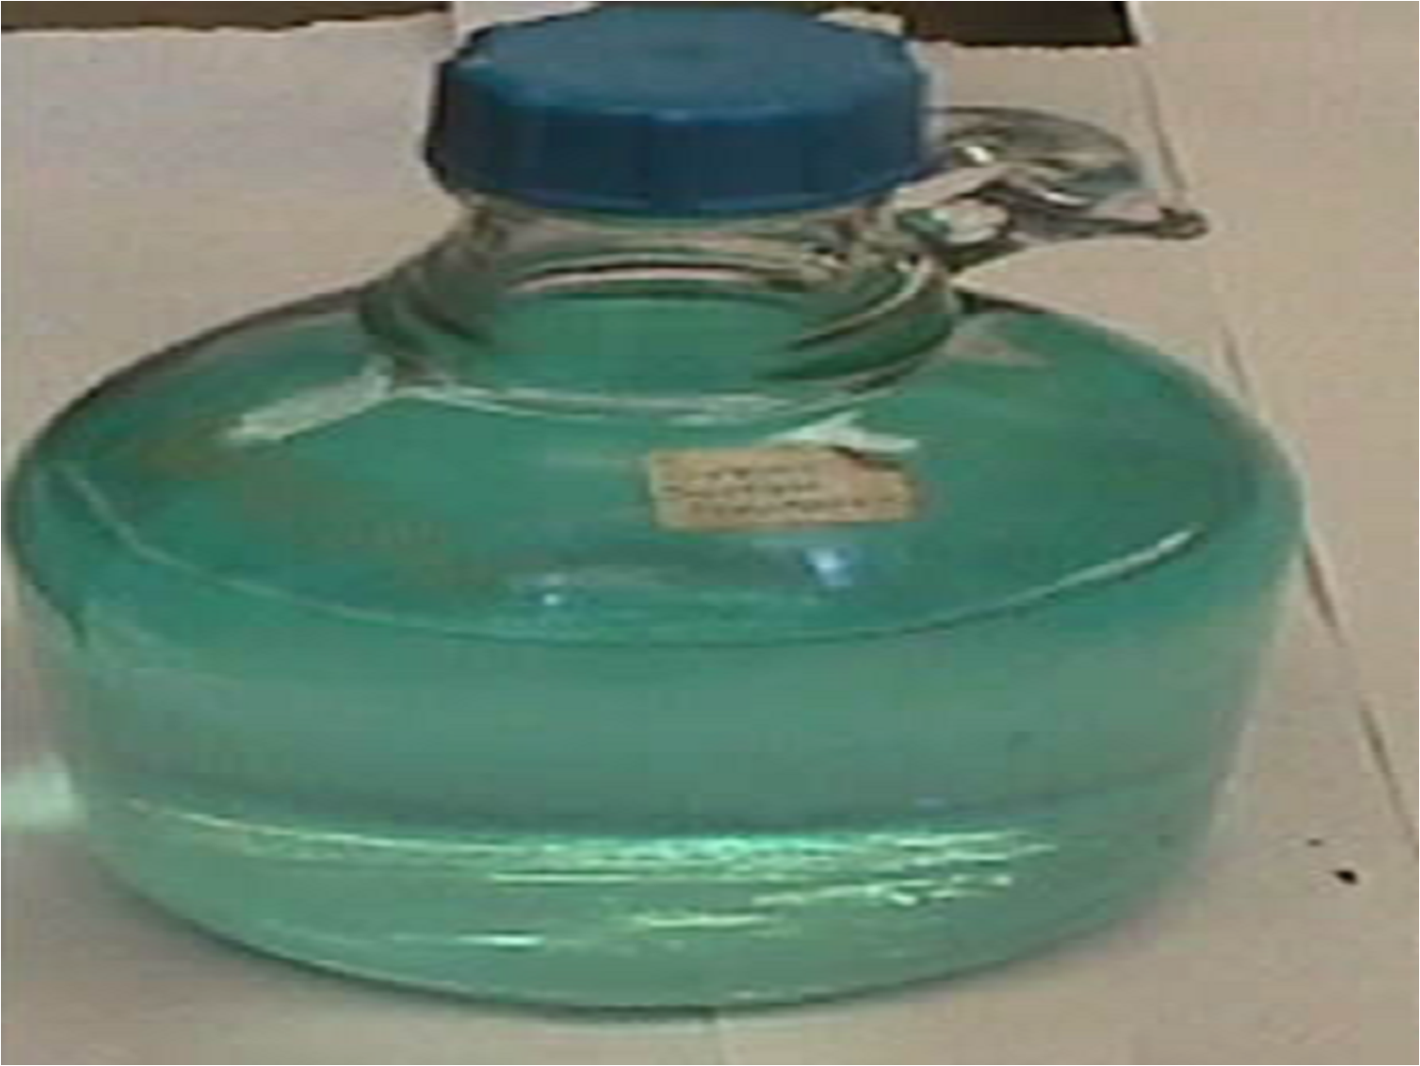

Slide 20
TESTING OF DISINFECTANTS :
There is no single reliable test to determine efficiency of a disinfectant
Traditionally PHENOL is taken as standard
RIDEAL-WALKER TEST:
-suspensions containing equal numbers of typhoid bacilli are submitted to action of varying conc. of phenol and of disinfectant to be tested

Slide 21
-the dilution of the test disinfectant which sterilizes the suspension in a given time, divided by corresponding dilution of phenol is stated as ‘PHENOL COEFFICIENT’ of the disinfectant DRAWBACK: this test doesn’t reflect natural conditions as the bacteria and disinfectant react directly without any organic matter being present -modifications have therefore suggested .

Slide 22
In CHICK-MARTIN TEST, the disinfectant acts in the presence of organic matter(dried yeast or feces ), even this modification falls short of simulating natural conditions CAPACITY TEST (KELSEY & SYKES TEST ) - designed to stimulate the neutral conditions under which like disinfectants are used in hospitals . - addition of test organism is made in increments with or without organic matter. No test is entirely satisfactory in determining the efficiency of disinfectant….

Slide 23
Hands Spread Disease
WASH
'EM !!!

