Slide 1
AUTO IMMUNE DISEASES

Slide 2
CLASSIFICATION
Hemocytolytic
Local (organ specific)
Systemic (non- organ specific)
Transitory

Slide 3
Hemocytolytic autoimmune diseases
Autoimmune hemolytic anemia
Auto immune thrombocytopenia
Autoimmune leucopenia
Auto immune hemolytic anemia :
Auto antibodies are formed against erythrocytes
Antibody coated RBC are destroyed in liver& spleen .
serologically autoantibodies are of 2 types
1. cold auto antibody
2. warm auto antibody

Slide 4
Cold Auto antibodies
Complete agglutinating Abs, belongs to IgM
Agglutinates RBC at 4ºc
Frequently seen in syphilis , 1º atypical pneumonia , trypanosoma & black water fever
Warm auto antibodies
Incomplete non- agglutinating Abs, belongs to IgG class
Can be seen in pt’s taking drugs like α-methyl Dopa, sulfonamides & other antibiotics .

Slide 5
Auto immune thrombocytopenia ( 1 in 10,000 )
Abs are formed against platelets
This condition can be seen in idiopathic throbocytopenic purpura .
Symptoms - epistaxis , bleeding gums, poor clotting , hematuria etc.,
Diagnosis - platelet count less than 20,000/µl .
Treatment - for acute ITP gluco corticoids or immunoglobulin
for chronic ITP corticosteroids .
Auto immune leukopenia
Abs are formed against leucocytes
This condition is seen in systemic lupus erythematosus & rheumatoid arthritis
Treatment - steroids & vitamins to activate bone marrow for the production of WBC.

Slide 6
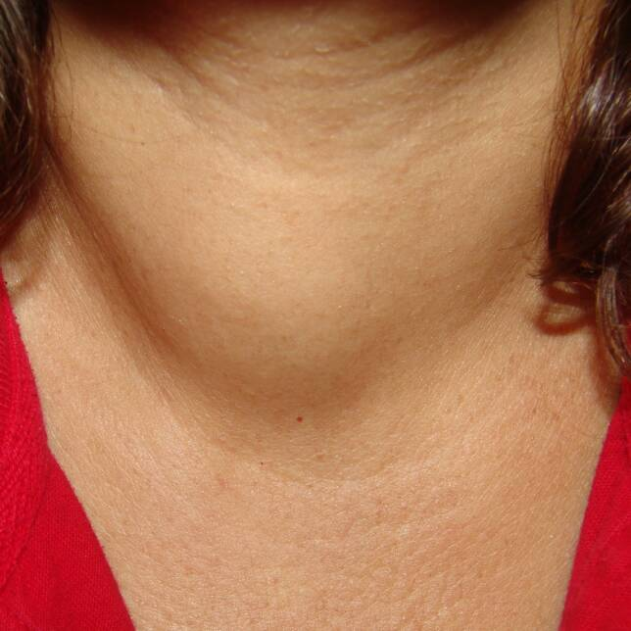
LOCAL AUTOIMMUNE DISEASES
Hashimoto’s disease (lymphadenoid goitre)
Chronic inflammation of thyroid gland ,frequently seen in females of age 40 – 60 yrs
Symptoms - feeling of fullness of throat , fatigue, weight gain & bradycardia . Along with symptoms of hypothyroidsm
Different specific Abs are formed against cell surface component & microsomal antigen
Histologically glandular tissue of thyroid is
replaced by lymphoid tissue

Slide 7
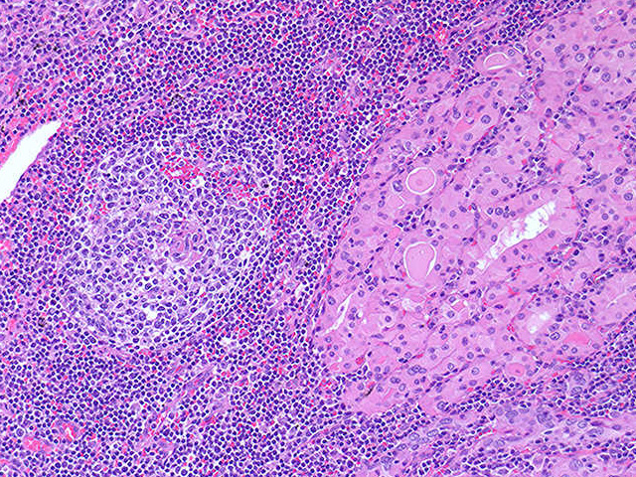
Diagnosis - 1. ultra sensitive TSH test
2.anti thyroid peroxidase Ab test which detects the presence of thyroid Ab’s
Treatment - synthetic thyroxin supplementation

Slide 8
Thyrotoxicosis ( grave’s disease)
Symptoms of this disease are related to hypothyroidsm includig enlargement of thyroid gland ,rapid pulse & wt. loss
Abs to thyroglobulin are formed along with lymphatic infiltration
Diagnosis - is by identification of “ long acting thyroid stimulator”
( LATS) which is an IgG Ab to thyroid membrane antigen
Treatment - 1. radio active iodine : available as capsules or solutions . It acts by localized death of thyroid tissue , but it is contraindicated in pregnancy as it causes birth defects
2.antithyroid drugs : like propylthiouracil & methimazole .acts by interfering with thyroid hormone synthesis
3.sugery : is needed in severe hypothyroidsm

Slide 9
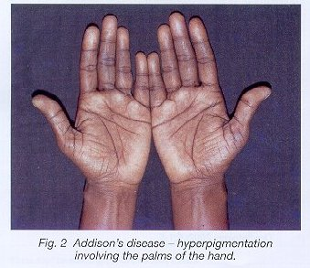
Addison’s disease :also called adrenal insufficiency / hypocortisolism .
Rarely it is due to def of aldosterone
Symptoms - wt.loss, muscle weakness, fatigue ,low B.P,dizziness, darkness of skin in both exposed & non- exposed parts of body.
Diagnosis - difficult to diagnose in early
Stages of disease .
main symptom to diagnose the disease
is darkening of skin .
Most specific test to dignose the disease
“ ACTH stimulation tset”
Lymphatic infiltration of adrenal glands & circulating Abs against cells of zona glomerulosa can be seen.

Slide 10
Contd.,
This condition is also induced in experiment animals with the injection of freund’s adjuvant into their adrenal glands
Treatment - is by replacement / substituting the hormones which are deficit .
Autoimmune orchitis :
Symptoms of this disease are - urethral discharge , scrotal pain ,frequency of urination , dysuria ,hematuria , fever & chills .
It can be also induced in exp. Animal – guinea pig by injection of freund’s adjuvant which leads to proggressive damage to germinal epithelium & aspermatogenesis

Slide 11
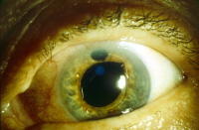
Autoimmune diseases of eye : two types
1. phacoanaphylaxis 2. sympathetic ophthalmia
Phacoanaphylaxis : is intraoccular inflammation after cataract surgery which is due to formation of Abs against lens proteins.
Treatment - A) NSAID’s , corticosteroids &
cycloplegics.
B) introccular lowering agents
like β-blockers , α-agonists & carbonic anhydrase inhibitors are used to lower the pressure .
Sympathetic ophthalmia : is a granulomatous inflammation of eye
Perforating injuries of eye, particularly of iris / ciliary body can leads to sympathetic ophthalmia in opp. Eye .

Slide 12
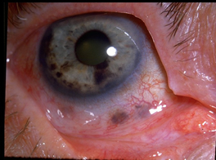
Contd.,
Treatment - 1. Acetonide
2. chlorambucil .

Slide 13
Pernicious anemia / addison’s anemia :
This disease is due to def of Vit – B 12, atrophy of gastric mucosa & lack of intrinsic factor .
Two types of auto antibodies are formed
- first one is against parietal cells of gastric mucosa which cause achlorohydria & atrophic gastritis .
- second one is against intrinsic factor which prevents the absorpyion of Vit B12
Diagnosis -1) Vit –B12 levels in blood
2) presence of Abs against intrinsic factor
3) iron & folate levels
Treatment - 1mg of Vit B12 is given IM everyday for 1 wk followed by 1mg every wk for 1 month & then 1mg every 1 month there after

Slide 14
Auto immune diseases of nervous system :
Rabies vaccinanation some times leads to injury of nervous system. This is due to formation of Abs against sheep nervous tissue ,which cross reacts with human nervous tissue .
Some examples of auto immune diseases of nervous system are - 1. Multiple sclerosis
2. Opsoclonus myoclonus syndrome
3. Experimental Allergic Encephalomyelitis ( EAE )
4. Idiopathic polyneuritis
5. Myasthenia gravis .

Slide 15
Myasthenia gravis :
This is abnormal fatiguability of muscles due to malfunctioning of NMJ.
In this disease Abs against Ach receptors of NMJ are formed which prevents the binding of Ach with the receptors
this leads to impaired muscle contraction .
Treatment - A).anticholinesterase agents like neostigmine , pyridostigmine are used which improve the neuro muscular transmission & increases the muscle strength.
B). Immunosuppressive drugs like prednisone, cyclosporine, azathioprine are used which supresses the producton of abnormal Abs .

Slide 16
Autoimmune diseases of skin : mainly three types
1. Pemphigus vulgaris
2. Bullous pemphigoid
3. Dermatitis herpatiformis .
Pemphigus vulgaris ;
It is characterized by blister formation on skin & mucosa .
This disease is due to formation of Abs against intercellular cement substance .
Symptoms - painful mouth lesions , blisters ,bullae & rashes on skin .
Treatment - RITUXIMAB , a monoclonal Ab to CD 20 .

Slide 17
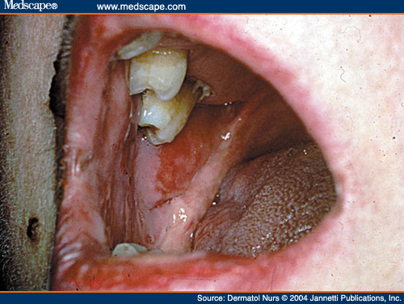
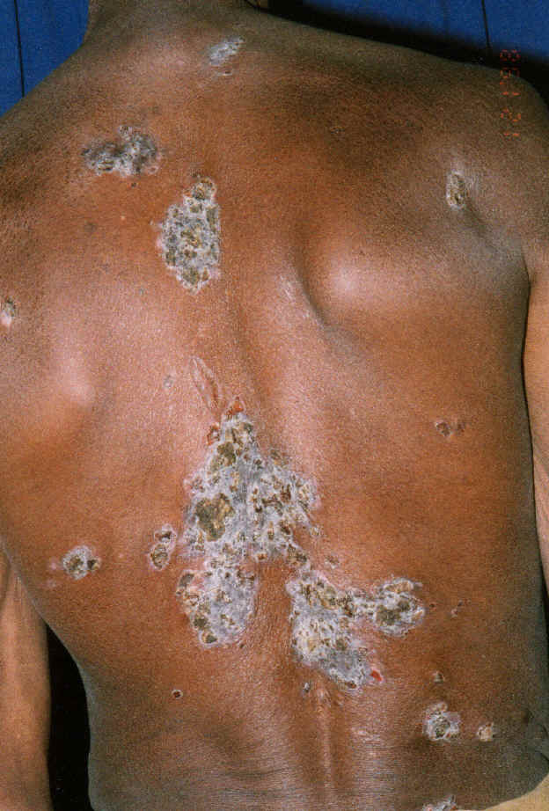

Slide 18
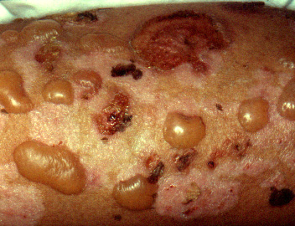
Bullous pemphigoid :
It is chronic auto immune disease of skin, commonly seen in elders.
This disease is due to formation of Abs against dermal epithelia junction.
Symptoms - eczema , rashes , hemarrhagic blisters ,increased skin pigmentation & inflammation .
Treatment - is by topical steroids , prednisone, methotrexate & clobetasol .

Slide 19
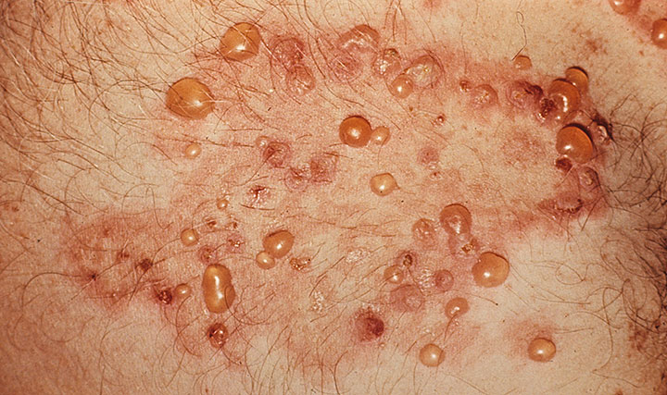
Dermatitis herpetiformis :
It is a rare auto immune disease of skin charecterised by papules ,vesicles & occasionally bullae.
Commonly males are afected than females.
This disease is due to formation of Abs against gliadin , which is a protein found in gluten fraction of wheat .
Treatment - DAPSONE , taking life long gluten free diet is better.

Slide 20
Thank YOU

